Slide 1
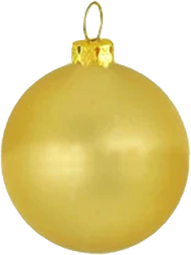
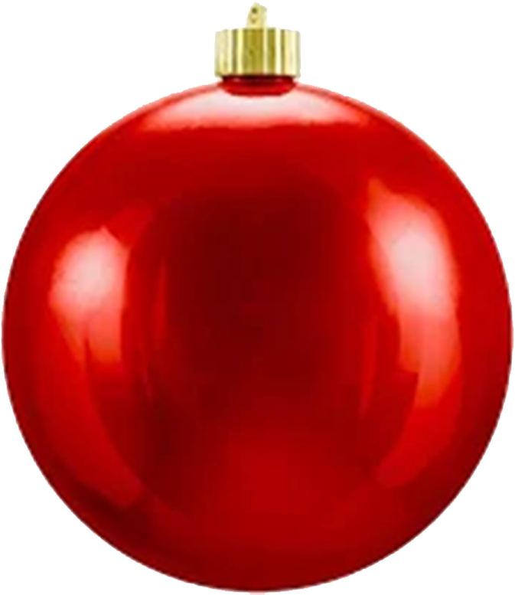
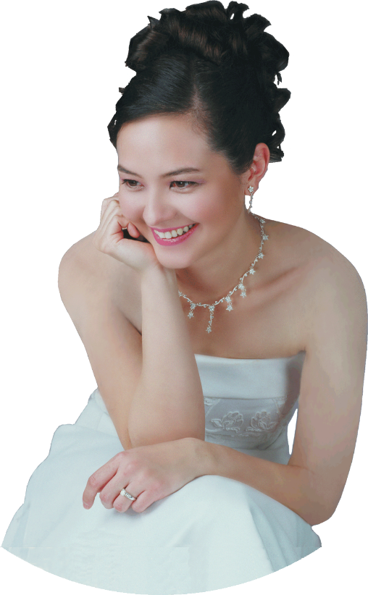
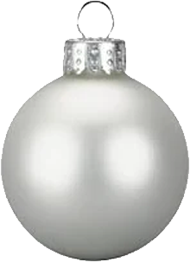
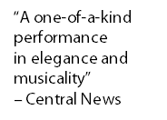
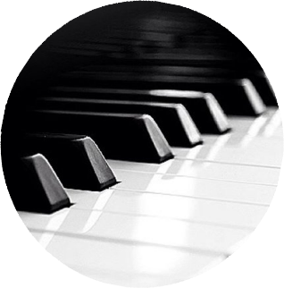
FRI
FRI
13
13
DEC
DEC
7:00P
7:00P
SandraShen.com
SandraShen.com
Menlo Church
950 Santa Cruz Ave, Menlo Park 650-323-8653
Free Admission
Menlo Church
950 Santa Cruz Ave, Menlo Park 650-323-8653
Free Admission

