Slide 1
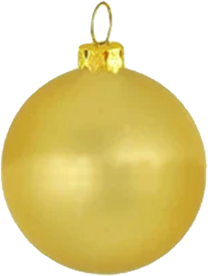
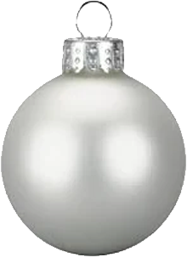
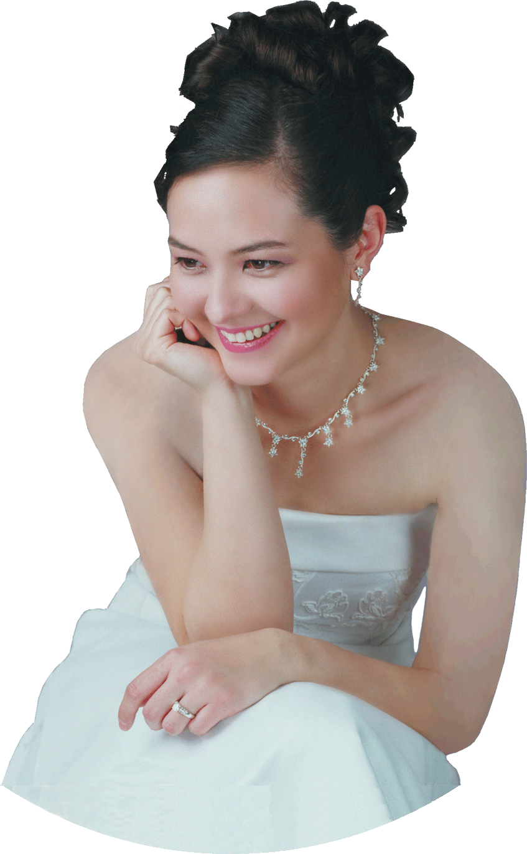
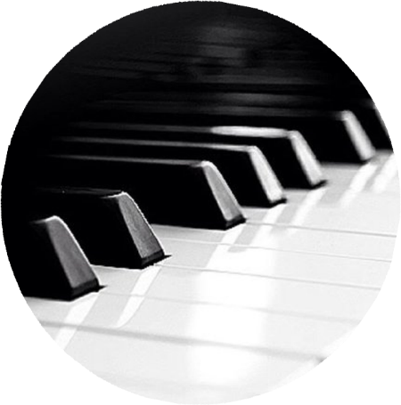
FRI
13
DEC
7:00P
“A one-of-a-kind performance
in elegance and musicality”
– Central News
Menlo Church
950 Santa Cruz Ave, Menlo Park 650-323-8653
Free Admission

