Slide 1
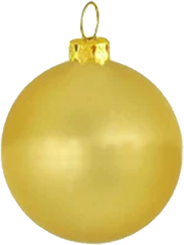
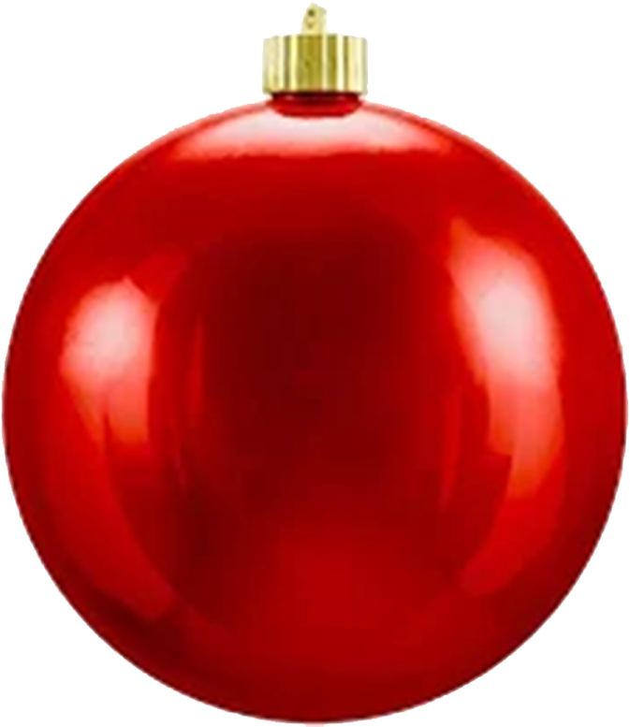
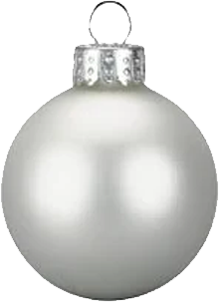
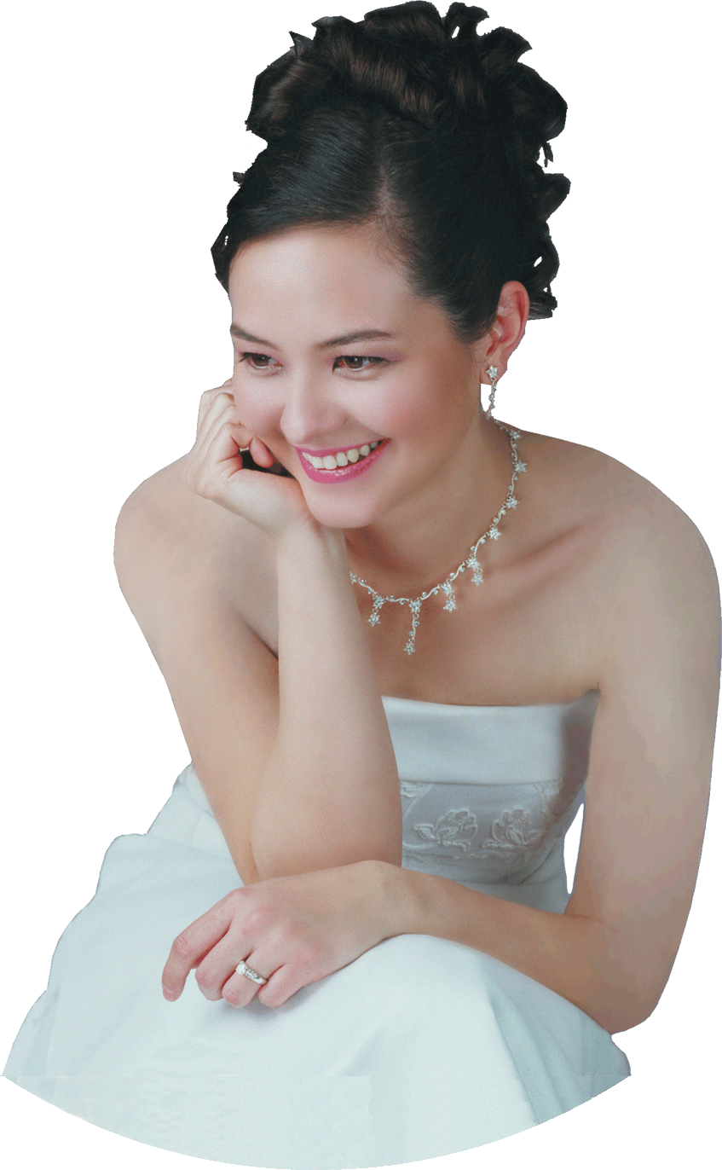
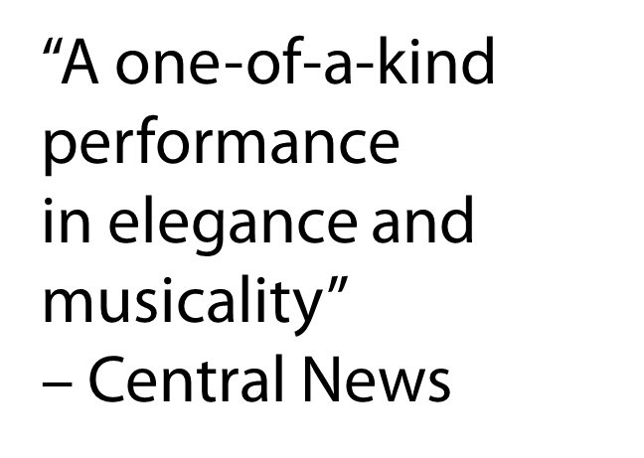
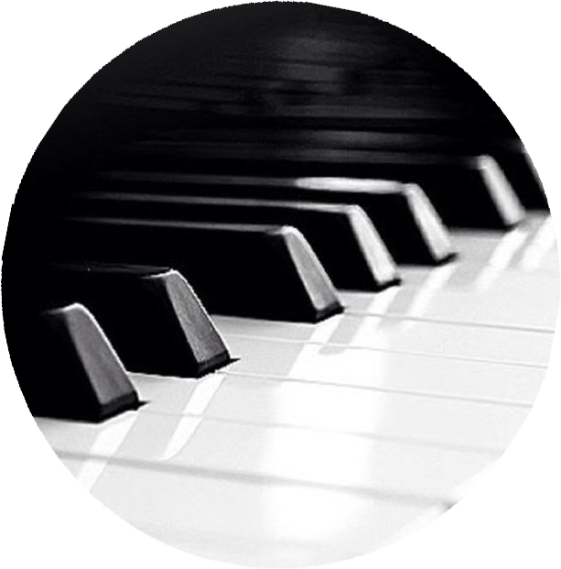
FRI
13
DEC
7:00P
Menlo Church
950 Santa Cruz Ave, Menlo Park 650-323-8653
Free Admission
Notes:
SANDRA Wright SHEN
1st Prize France Intl Piano Competition
1st Prize Hilton Head Intl Piano Competition
Steinway Artist
SandraShen.com
“A one-of-a-kind performance in elegance and musicality” – Central News
Inspiration From Above 5 :
JOY TO THE WORLD
Christmas-themed classical music to explore the birth of Jesus

Slide 2
