Slide 1
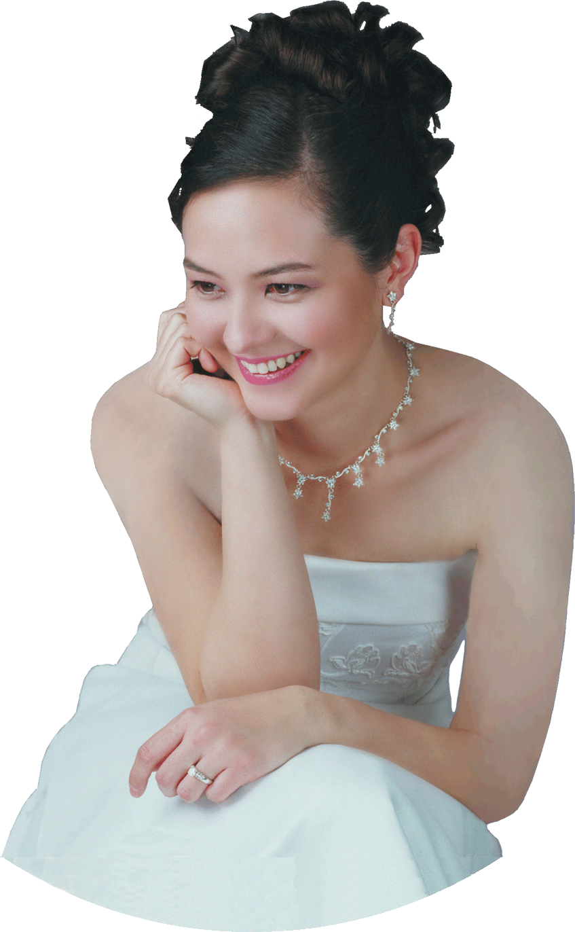
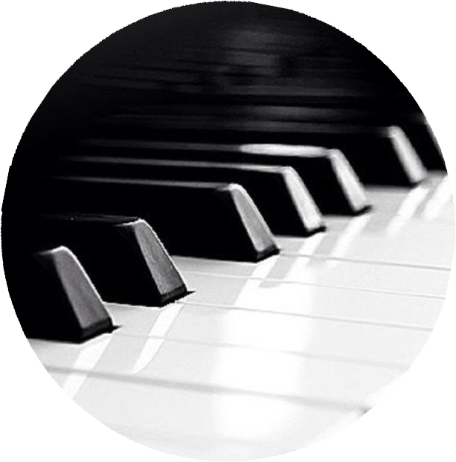
SAT
SANDRA Wright SHEN
02
1st Prize France Intl
1st Prize Hilton Head Intl
Steinway Artist
JUNE
7PM
“A one-of-a-kind performance
in elegance and musicality”
– Central News
SandraShen.com
Inspiration From Above 3
ETERNITY IN OUR HEARTS
Investigating eternal life through the music of Chinese composers
Chinese Bible Church of Maryland
4414 Muncaster Mill Rd, Rockville MD
cbcm.org (301) 924-4855
Free Admission

Slide 2
