Slide 1
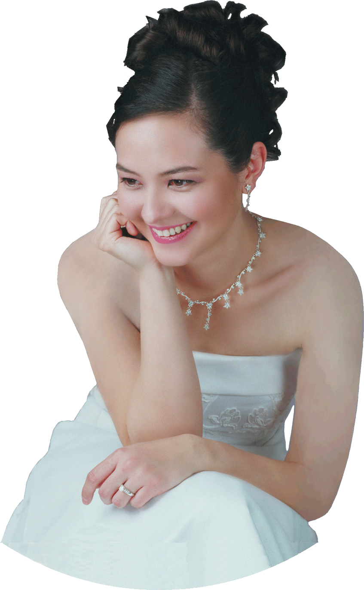
SAT
02
SANDRA Wright SHEN
JUNE
1st Prize France Intl
1st Prize Hilton Head Intl
Steinway Artist
7PM
“A one-of-a-kind performance
in elegance and musicality”
– Central News
SandraShen.com
Inspiration From Above 3
Eternity in our Hearts
Unveiling the secret spiritual lives of more great composers
Chinese Bible Church of Maryland
4414 Muncaster Mill Rd, Rockville MD
cbcm.org (301) 924-4855
Free Admission

