Slide 1
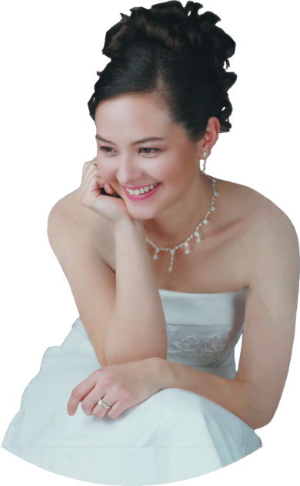
SANDRA WRIGHT SHEN
SAT
SANDRA WRIGHT SHEN
SAT
1st Prize France Intl
1st Prize Hilton Head Intl
Steinway Artist
1st Prize France Intl
1st Prize Hilton Head Intl
Steinway Artist
21
21
APR
APR
7PM
“A one-of-a-kind performance
in elegance and musicality”
– Central News
7PM
“A one-of-a-kind performance
in elegance and musicality”
– Central News
Inspiration From Above 2
Inspiration From Above 2
Unveiling the secret spiritual lives of more great composers
Unveiling the secret spiritual lives of more great composers
Chinese Evangelical Free Church
1111 S. Atlantic Blvd
Monterey Park
Free Admission
Chinese Evangelical Free Church
1111 S. Atlantic Blvd
Monterey Park
Free Admission

