Slide 1
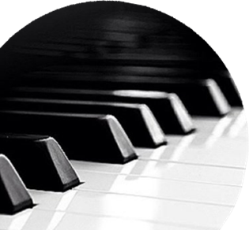
SAT
SANDRA WRIGHT SHEN
SAT
SANDRA WRIGHT SHEN
1st Prize France Intl
1st Prize Hilton Head Intl
Steinway Artist
Piano Chair, SF Conservatory Pre-College
1st Prize France Intl
1st Prize Hilton Head Intl
Steinway Artist
Piano Chair, SF Conservatory Pre-College
05
05
OCT
OCT
7:30p
7:30p
sandrashen.com
sandrashen.com
Inspiration From Above 2: Meaning of Life
Inspiration From Above 2: Meaning of Life
Unveiling the secret spiritual lives of Haydn, Schubert, Mendelssohn, Brahms and Handel
Unveiling the secret spiritual lives of Haydn, Schubert, Mendelssohn, Brahms and Handel
Valley Church
10885 N. Stelling, Cupertino, CA FREE ADMISSION
valleychurch.org
Valley Church
10885 N. Stelling, Cupertino, CA FREE ADMISSION
valleychurch.org
Sandra has played over 350 “Inspiration From Above” concerts in 12 countries; televised in US, HK, Taiwan. Whether you are a classical music lover or novice, you will be touched!
Sandra has played over 350 “Inspiration From Above” concerts in 12 countries; televised in US, HK, Taiwan. Whether you are a classical music lover or novice, you will be touched!

