Slide 1
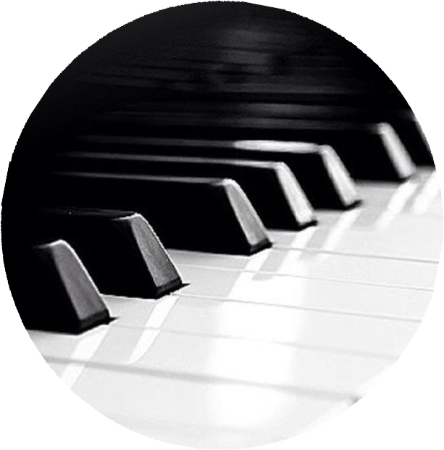
SANDRA WRIGHT SHEN
1st Prize France Intl
1st Prize Hilton Head Intl
Steinway Artist
Piano Chair, SF Conservatory Pre-College
SAT
Valley Church
10885 N. Stelling, Cupertino, CA FREE ADMISSION
valleychurch.org
05
OCT
sandrashen.com
7:30p
Inspiration From Above 2: Meaning of Life
Unveiling the secret spiritual lives of Haydn, Schubert, Mendelssohn, Brahms and Handel

