Slide 1
SAT
SANDRA WRIGHT SHEN
1st Prize France Intl
1st Prize Hilton Head Intl
Steinway Artist
21
APR
7PM
“A one-of-a-kind performance
in elegance and musicality”
– Central News
SandraShen.com
Inspiration From Above 1
Unveiling the secret spiritual lives of the great composers
Chinese Evangelical Free Church
1111 S. Atlantic Blvd
Monterey Park
Free Admission

Slide 2
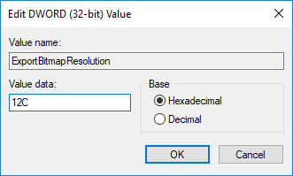
Instructions for printing this PowerPoint:
1) Edit the location, date and time
2) Save the file
3) In the lower left corner next to the Start
button, type “regedit” in the search box.
4) Click Yes if it asks for Permission.
5) Click on the > next to HKEY_CURRENT_USER
6) On the next level, click on the > next to Software
7) On the next level, click on the > next to Microsoft
8) On the next level, click on the > next to Office
9) Depending on the version of your Powerpoint, you will either
click on the arrow next to “16.0”, “15.0”, “14.0”, “12.0” or “11.0”.
10) On the next level, click on the > next to Powerpoint
11) Click on Options.
12) Click the Edit menu at the top, then select New and DWORD (32-bit) Value
13) Type ExportBitmapResolution and press Enter.
14) Make sure that ExportBitmapResolution is selected
and then click Edit menu and Modify
15) In the Value data box, type 12C. Click OK
16) Click File, Exit to exit Registry Editor
17) Close PPT and re-open the presentation
18) Make sure Current Slide is slide 1
19) On the File menu, click Save As
20) Select PNG as file type
21) Click Current Slide only
You only have to do this once per PC
Type this.
Then this appears,
double-click it

