Slide 1
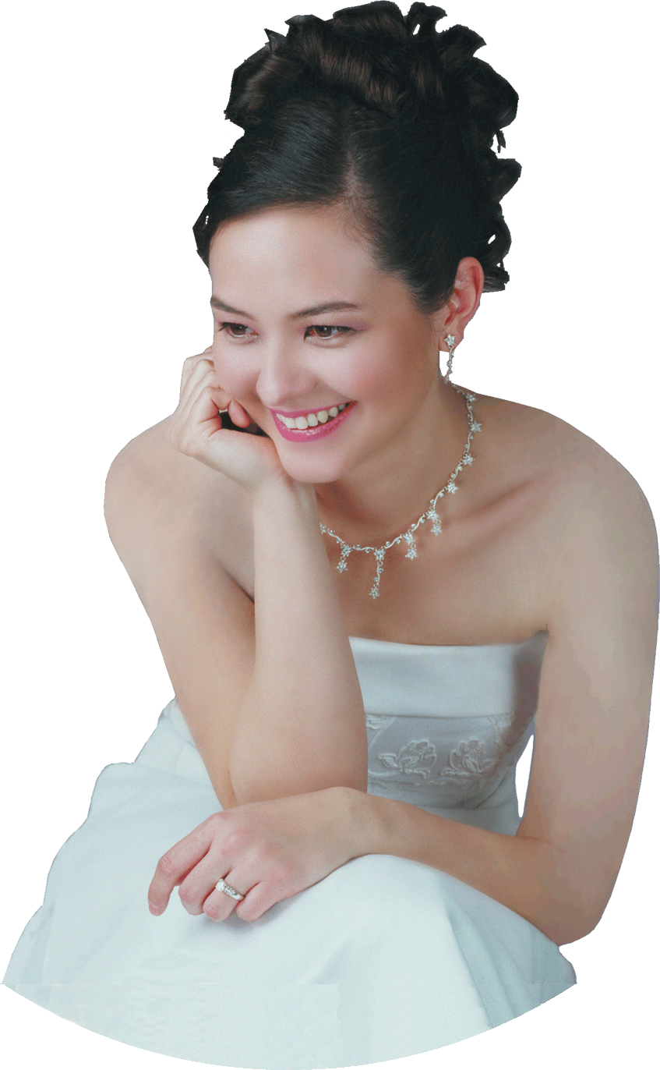
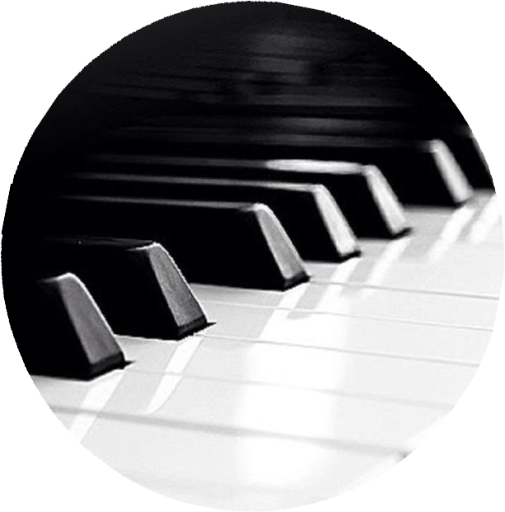
SAT
SANDRA WRIGHT SHEN
21
1st Prize France Intl
1st Prize Hilton Head Intl
Steinway Artist
APR
7PM
“A one-of-a-kind performance
in elegance and musicality”
– Central News
SandraShen.com
Inspiration From Above 1
Unveiling the secret spiritual lives of the great composers
Chinese Evangelical Free Church
1111 S. Atlantic Blvd
Monterey Park
Free Admission

Slide 2
