Slide 1
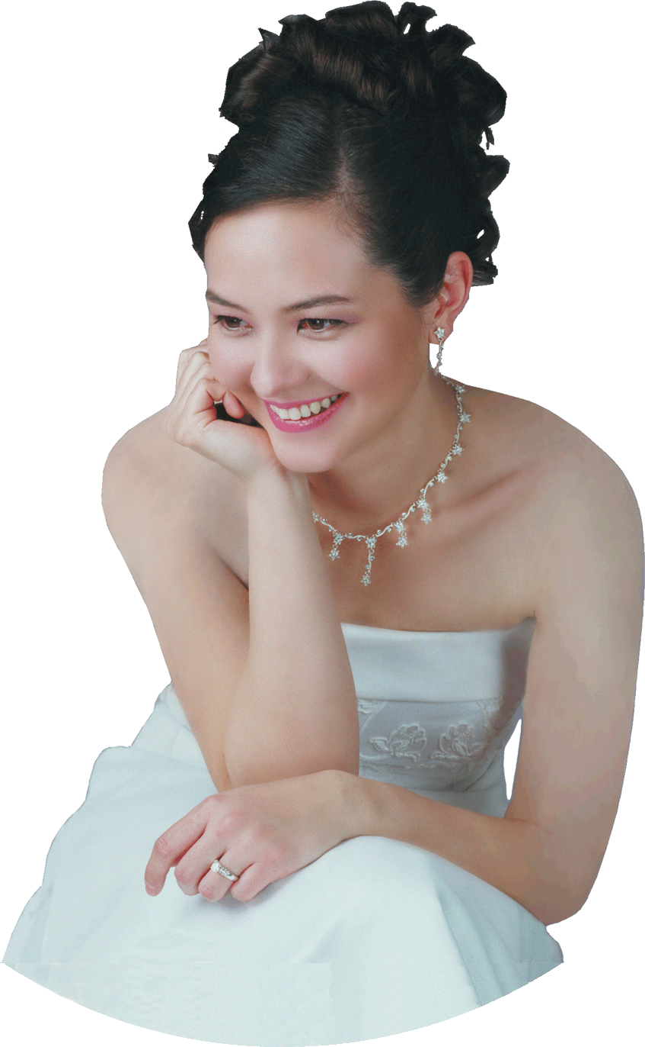
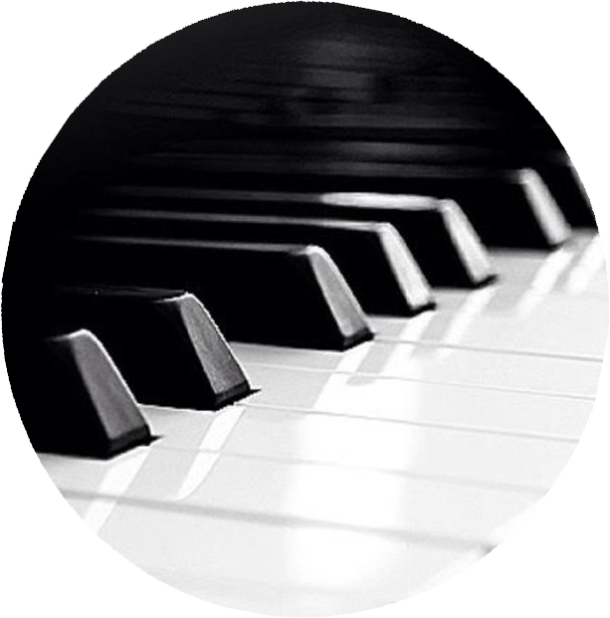
SANDRA WRIGHT SHEN
“A one-of-a-kind performance
in elegance and musicality”
– Central News
1st Prize France Intl
1st Prize Hilton Head Intl
Steinway Artist
SAT
21
Evangelical Free Church
1234 S. Main St.
Los Altos
FREE ADMISSION
APR
7PM
Inspiration From Above 1
Unveiling the secret spiritual lives of the great composers

